Slide 1
Fine-Grained Lineage for Safer Notebook Interactions
M. Chalke, F. Escudero, N. Lyubenko

Slide 2
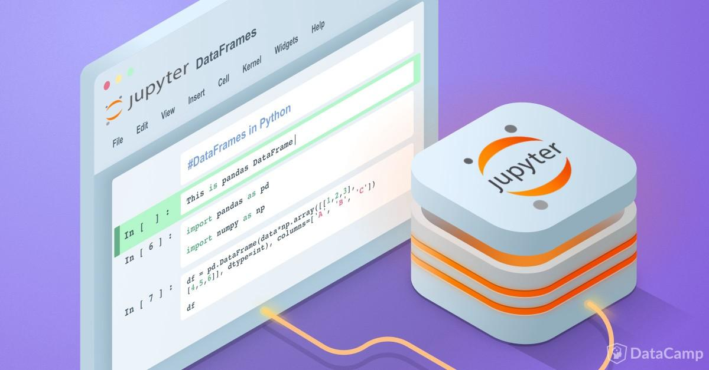
BACKGROUND
Computational Notebooks
Used in data science and analytic workflows
Program execution state saved in-Memory
Segmented cells allow tight feedback
Facilitates ad hoc exploratory nature of data science
Notes:
Nic

Slide 3

CHALLENGES
Automatically detecting unsafe notebook interactions across cells
Static analysis conservative yet necessary to throw a warning
Efficient dynamic analysis is difficult to achieve
Automatically resolving unsafe behavior with suggested fixes
Identify which cells to run to resolve staleness issues
Monitoring interactive levels of performance
Latency and Memory Usage
Lineage Metadata size
Notes:
Nic

Slide 4
PROPOSED INNOVATIONS
NBSAFETY - Innovative library that developed techniques to automatically identify and prevent potentially unsafe cell interactions
First to address these challenges while preserving notebook semantics
Any order execution approach
A custom Jupyter kernel and frontend
Automatically detects unsafe interactions and alerts users
Maintains interactive levels of performance
Preserves existing notebook semantics
Installation on single command - replacement for Jupyter’s built-in Python 3 kernel
Notes:
Nic

Slide 5

PROPOSED INNOVATIONS
To address the aforementioned challenges, NBSAFETY performs
Efficient and accurate detection of staleness issues
Efficient resolution of staleness issues
Notes:
Nic

Slide 6

ARCHITECTURE
Tracer
Maintains dependencies as lineage metadata
Leverages Python’s tracing capabilities
Execution, calls, return and exceptions
Checker
Performs liveness analysis (references to stale symbols)
Followed by initialized variable analysis (resolutions)
Frontend
Combines results with metadata to highlight unsafe cells
Notes:
Quico

Slide 7
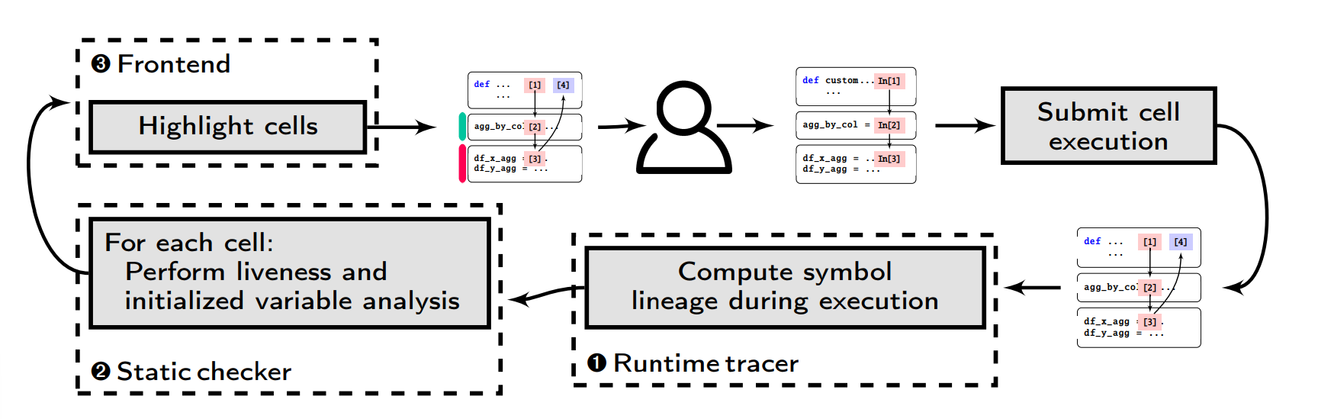
ARCHITECTURE
Notes:
Quico

Slide 8

LINEAGE TRACKING
Used to track staleness
Symbols - Any piece of data
Timestamp - Counter recording the most recent execution
Dependencies - Symbols contributing to computation
Any symbol is stale if:
there is a more up-to-date parent
it has stale parent
Notes:
Quico

Slide 9
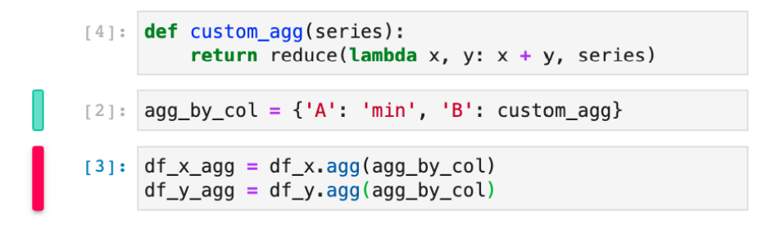
LINEAGE TRACKING
Cell 1
Cleanup suggestion
Cell 2
Staleness warning
Cell 3
Notes:
Quico

Slide 10
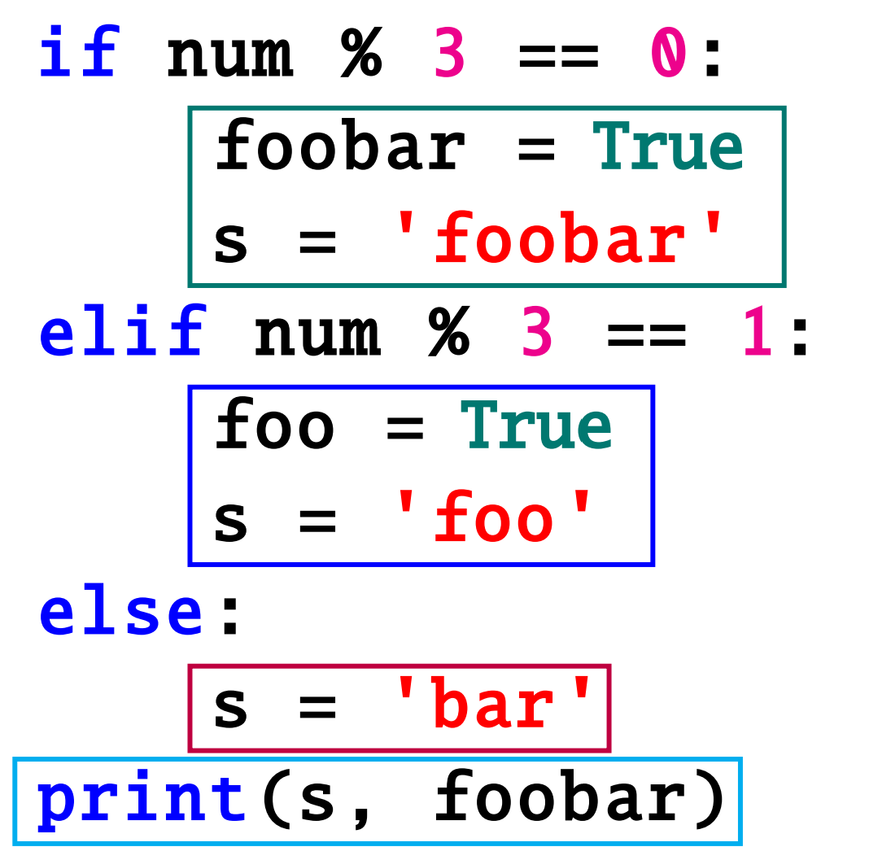
LIVELINESS ANALYSIS
Identifies cells unsafe for execution
Determines stale references & uninitialized variables
Live Symbol: Execution path exists - value of a symbol is used later in the program
Dead Symbol: Every path executes independent of current symbol value
Stale Cell: Has a live reference to stale symbol
Fresh Symbol: Not stale and has a latest timestamp
Fresh Cell: Not stale and has a live reference to a fresh symbol
Refresher Cell: Not a stale cell and has fewer live stale symbols than a stale cell
Notes:
Maitreyi

Slide 11
CELL HIGHLIGHTS
Lineage metadata combined with static checking output to highlight cells
Stale cells given Staleness Warnings
Fresh Cells given CleanUp Suggestions
Refresher Cells given CleanUp Suggestions
Hypothesis 1: Highlighted cells with staleness issues likely to be avoided by real users
Hypothesis 2: Highlighted fresh and refresher cells likely to be selected for re-execution
Notes:
Maitreyi

Slide 12

EMPIRICAL STUDY RESULTS
666 Notebook Sessions
117 Sessions with potential safety errors
Examples of confusion and wasted effort
549 Sessions - Cells identified as resolving safety issues
7x likely to be re-executed
Notes:
Maitreyi

Slide 13

CONCLUSION
NBSAFETY - A Kernel and Frontend for Jupyter
Detection and correction of unsafe notebook interactions
Preserving flexibility and familiarity of any-order semantics
Integrated tracer, checker, frontend into existing workflow
Reduced error-proneness efficiently using warnings
Scales gracefully to any-sized notebooks
Notes:
Maitreyi

Slide 14
REFERENCES
Fine-Grained Lineage for Safer Notebook Interactions,
Stephen Macke, Aditya G. Parameswaran, Hongpu Gong, Doris Jung Lin Lee, Doris Xin,
Andrew Head, Proc. VLDB Endow., 2021.

